Slide 1





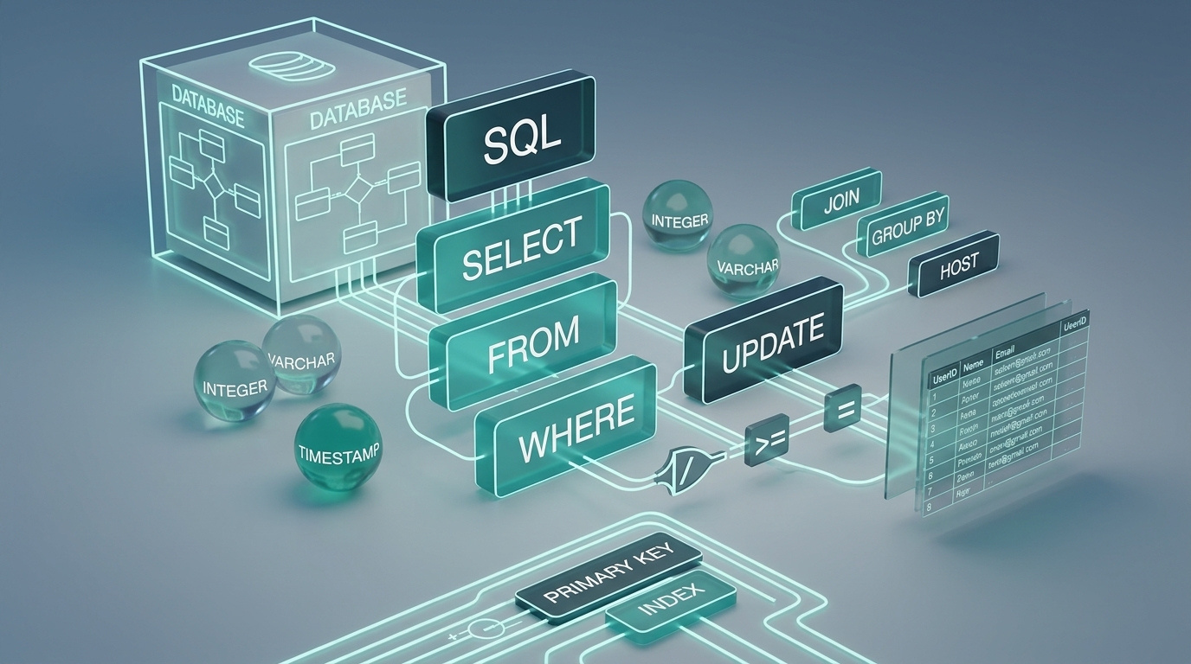




DATA ANALYSIS
JAVASCRIPT FUNDAMENTALS
Module 3: SQL & Databases
Module 3: SQL and Databases
Warehousing Fundamentals
Primitive
Data Types
Topic 5 of 6
Topic 5 of 6

Slide 2


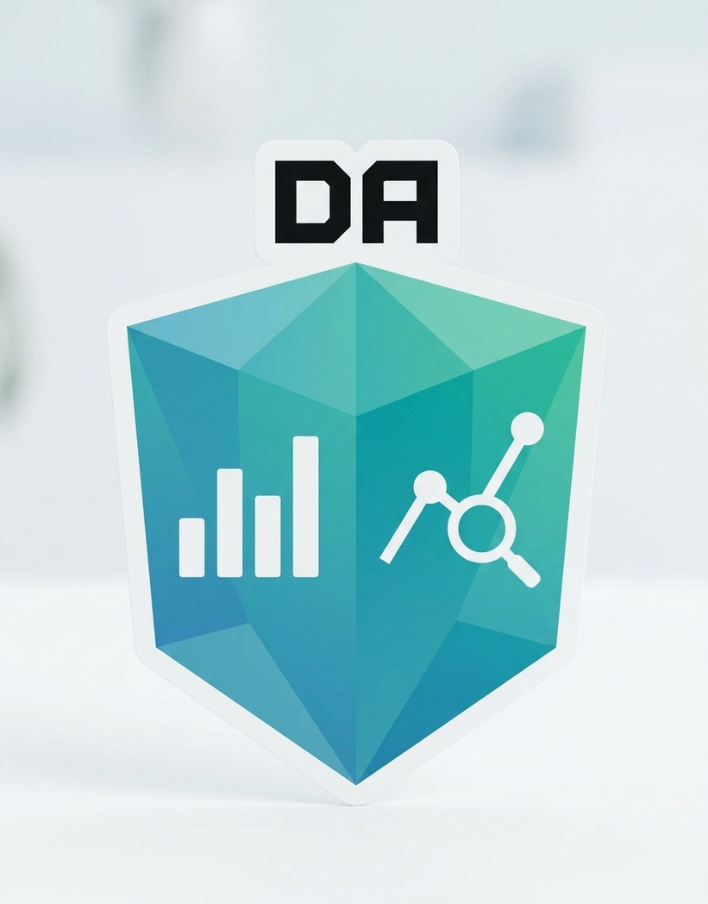


Learning outcome
By the end of this topic, the trainee can…
1- Describe the difference between a transactional database and a data warehouse — what each is built to do well.
2- Spot the table in a star schema that holds measurable events and foreign keys to everything else.
3- Spot the tables that describe who, what, when and where — the context around each fact.

Slide 3
Why this matters
The report that slowed down checkout
Finance asked for total revenue by product category, by month, across the last two years — for the board meeting.
Someone ran it straight against the live database — the same one customers’ checkouts write to every second.
The query scanned millions of rows across five joined tables. For eleven minutes, checkout was slow for every real customer in every city.
The report and the app were never supposed to share a database in the first place.

Slide 4
CONCEPT 1 OF 9
OLTP — built for one transaction at a time
OLTP stands for Online Transaction Processing — the everyday database behind an app.
Every table you've queried since 3.1 — customers, orders, order_items, products, payments — is an OLTP schema.
Optimised for: one customer placing one order right now, reliably, without corrupting anyone else's data.
Normalised into many small linked tables — exactly the primary-key/foreign-key structure from 3.1 — so a single row updates fast and safely.
What OLTP is good at
“Chidinma just placed order #5001 — save it instantly, and don't let two staff members overwrite each other's edit.” Many small, fast, safe writes and reads, all day, every day.

Slide 5
CONCEPT 2 OF 9
The data warehouse — built for big historical questions
A data warehouse holds a separate copy of the data, reshaped specifically for analysis — not for running the app.
Sometimes called OLAP (Online Analytical Processing): fewer, heavier queries, instead of many small fast ones.
Loaded on a schedule — hourly, nightly — by a process that copies and reshapes data out of OLTP systems. This module doesn't build that process, just the shape it produces.
Because it's a separate copy, a slow eleven-minute report here never touches the live checkout database.
What a warehouse is good at
“Give finance total revenue by category, by month, across the last two years” — scanning millions of historical rows, without anyone at checkout noticing.

Slide 6
CONCEPT 3 OF 9
OLTP vs. the warehouse, side by side
OLTP (customers, orders…)
Data warehouse
Built for
Running the app, right now
Analysing history, at scale
Typical query
One customer's one order
Millions of rows, summarised
Shape
Normalised — many linked tables
Star schema — fact + dimensions
Updated
Constantly, as events happen
On a schedule — hourly or nightly
Optimised for
Fast, safe single-row writes
Fast, heavy aggregate reads
Neither is “better”: they're built for opposite jobs. Eko Traders needs both — OLTP to run the business today, a warehouse to understand it over time.

Slide 7
CONCEPT 4 OF 9
Why not just query the OLTP tables?
3.1's normalisation was the right call for the app: no duplicate data, safe fast updates, one source of truth per fact.
But finance's question needs orders joined to order_items joined to products joined to customers — four joins, across the busiest tables in the system, over years of history.
That's the exact opposite of what OLTP tables are tuned for: small, targeted lookups, not sweeping historical scans.
A warehouse pre-joins and reshapes the data ahead of time, so the heavy work happens once, off to the side — not live, every time someone asks a question.
Connects to 3.4: the row-count prediction habit you built for a 2-table join gets much harder to hold in your head across 4+ joins and millions of rows — another reason the warehouse pre-shapes things for you.

Slide 8
CONCEPT 5 OF 9
The star schema — one fact, several dimensions
dim_date
date, month, quarter, year
fact_sales
dim_customer
dim_product
quantity, line_total
full_name, city, tier
grain: one line item sold
product_name, category
The gold-bordered box in the middle is the fact table — it sits at the centre and connects out to every dimension, like a star.
Each teal or gold dimension box describes one axis you might want to slice the facts by: when, who, what.

Slide 9
CONCEPT 6 OF 9
Fact tables — the events, and the numbers
A fact table holds one row per measurable event — that's its grain, the same idea from 3.1, applied to an event instead of an entity.
It's mostly numbers (measures) you can SUM, AVG or COUNT — quantity, line_total — plus foreign keys pointing out to every dimension.
Fact tables are the biggest, fastest-growing tables in a warehouse — every sale adds a new row.
Rule of thumb: if a column is something you'd aggregate, it's probably a fact table column.
sale_key
date_key
cust_key
prod_key
qty
total
F1
D1
101
P1
2
16000
F2
D1
103
P2
1
25000
F3
D2
106
P3
5
7500
Grain: one row = one line item sold. Every column is either a foreign key or a measure — nothing else.
Spotting a fact table
Lots of numeric columns you'd want to add up
Several _key or _id columns pointing to other tables
One of the biggest, longest tables in the schema
Name often starts with fact_

Slide 10
CONCEPT 7 OF 9
Dimension tables — the who, what, when and where
A dimension table describes something the fact table references — a customer, a product, a date.
Mostly text and descriptive attributes: full_name, city, category — the columns you'd GROUP BY, not SUM.
Far smaller and slower-growing than the fact table — Eko Traders adds customers occasionally; it logs sales constantly.
Rule of thumb: if a column is something you'd group or filter by, it's probably a dimension table column.
product_key
product_name
category
P1
Rice Bag 5kg
Groceries
P2
Bluetooth Speaker
Electronics
P3
Biscuit Pack
Snacks
dim_product — one row per product, describing it, never a measure to sum.
Spotting a dimension table
Mostly text: names, categories, cities, tiers
One clear primary key, few or no foreign keys out
Small and fairly stable — doesn't grow with every sale
Name often starts with dim_

Slide 11
CONCEPT 8 OF 9
Where the warehouse tables come from
Nothing here is brand new data — it's Eko Traders' own OLTP tables, reshaped for analysis.
OLTP table (3.1–3.4)
→
Warehouse table
Becomes
customers
→
dim_customer
a dimension
products
→
dim_product
a dimension
order dates
→
dim_date
a new dimension, built for this purpose
order_items
→
fact_sales
the fact table
Why order_items, not orders?
An order can contain several products — order_items already has the right grain: one row per product sold, which is exactly what fact_sales needs. orders alone is one row too coarse.

Slide 12
CONCEPT 9 OF 9
Querying a star schema: nothing new to learn
A star schema query is still SELECT, JOIN, WHERE, GROUP BY, ORDER BY — every clause from 3.2–3.4, in the same fixed order.
The only difference: you JOIN the fact table to whichever dimensions hold the columns you need, then GROUP BY the dimension's descriptive columns.
Row-count prediction still applies — you're still joining tables, just fact-to-dimension instead of parent-to-child.
SELECT p.category, SUM(f.line_total) AS revenue
FROM fact_sales f
JOIN dim_product p ON f.product_key = p.product_key
GROUP BY p.category
ORDER BY revenue DESC;

Slide 13
WORKED EXAMPLE · PART 1 OF 2
Reading the schema before querying it
Business question: “What was our revenue by product category in Q1 2026?”
Step 1 — find the fact table
Step 2 — find the right dimensions
fact_sales: mostly numbers (quantity, line_total), several _key columns, one row per line item sold. That's our fact table — and the source of the measure we need, line_total.
category lives in dim_product, not fact_sales — so we need that join. The Q1 2026 filter needs dim_date too. dim_customer isn't needed at all for this question.
Predict before writing SQL: revenue should split across 3 categories in our sample — Groceries, Electronics, Snacks — with 2026's Q2 sale excluded entirely.

Slide 14
WORKED EXAMPLE · PART 2 OF 2
Writing and verifying the query
category
revenue
SELECT p.category, SUM(f.line_total) AS revenue
FROM fact_sales f
JOIN dim_product p ON f.product_key = p.product_key
JOIN dim_date d ON f.date_key = d.date_key
WHERE d.quarter = 'Q1 2026'
GROUP BY p.category
ORDER BY revenue DESC;
Electronics
43000
Groceries
34000
Snacks
7500
Same shape of answer as 3.3's aggregation work — just sourced from a warehouse table instead of an OLTP one.
Verify: 3 rows came back, one per category, and the Q2 2026 sale of a Bluetooth Speaker doesn't appear anywhere in the total — exactly as predicted.

Slide 15
GUIDED PRACTICE · YOUR TURN
Eko Traders starts tracking deliveries
New schema: Eko Traders now logs every delivery. Three tables: deliveries_log (delivery_key, date_key, store_key, driver_key, distance_km, delivery_fee), stores (store_key, store_name, city), drivers (driver_key, driver_name, vehicle_type).
Your task
Before you answer
Identify which table is the fact table, and which two are dimension tables.
For each, write one sentence justifying your answer using this topic's rules of thumb.
Name the grain of the fact table — what does one row represent?
Suggest one more dimension Eko Traders could add later.
Don't just spot the name pattern — check the actual columns against the rules of thumb from concepts 6 and 7.
Which columns are measures? Which are foreign keys? Which are descriptive text?
A table can look small in this example and still be a fact table — size in our sample isn't the real test, shape is.

Slide 16
GUIDED PRACTICE · SOLUTION
One fact table, two dimensions
FACT TABLE
DIMENSION
deliveries_log
stores
store_name and city are descriptive text — you'd GROUP BY these, never SUM them. Small, stable table.
distance_km and delivery_fee are measures — things you'd SUM or AVG.
date_key, store_key, driver_key are foreign keys out to every dimension.
Grain: one row = one completed delivery. It grows with every delivery, same pattern as fact_sales.
DIMENSION
drivers
driver_name and vehicle_type describe the driver, don't change per delivery in the same way a measure would, and there are far fewer drivers than deliveries.

Slide 17

Key Takeaways
You can now explain OLTP vs. data warehouse: OLTP runs the app with many small safe transactions; a warehouse answers big historical questions from a separate, reshaped copy.
Up Next:
AI as Your SQL Pair
You can now identify fact tables: Numeric measures, several foreign keys, huge and fast-growing — one row per measurable event.
You can now identify dimension tables: Descriptive text, one clear primary key, small and stable — the who, what, when and where around a fact.

Slide 18
WHAT'S NEXT
From this session into the lab
1
2
3
Hands-on lab
LMS practice set
Keep the habit
Open the sample warehouse tables (fact_sales, dim_date, dim_customer, dim_product) and complete the 3.5 worksheet — schema identification plus two star-schema queries.
Eight auto-graded questions: OLTP vs. warehouse scenarios, and labelling fact vs. dimension tables in schemas you haven't seen yet.
Before touching a new schema, ask 'what's the grain?' and 'which table has the measures?' before writing any SQL at all.
Facilitator note: pre-built finished warehouse file (eko_traders_warehouse_finished.db) and a schema diagram printout are attached on the LMS in case the live demo or network fails.

